Slide 1

Intelligent Vehicle Damage Assessment & Cost Estimator For Insurance Companies
By
CH.SRAVANTHI (19481A0539)
G.NIKHILA (19481A0557)
J.DIVYA SRI (20481A0506)
CH.ABHILASH (19481A0537)

Slide 2
Abstract:-
Vehicle damage detection is used to reduce claims leakage during insurance processing. Visual inception and validation are usually done. As it takes a long time, because a person needs to come and inspect the damage. Here we are trying to automate the procedure. Using this automation, we can avoid time conception for the insurance claim procedure.

Slide 3
Objectives:-
A method for automatically estimating a repair cost for a vehicle.
We build a VGG16 which can detect the area where damage is occurred .
It also detects how much amount is actually required to repair the damaged area of a car.

Slide 4
Related Work:-
The user interacts with the UI (User Interface) to choose the image.
The chosen image is analyzed by the model which is integrated with the flask application.
VGG16 Model analyzes the image, then the prediction is showcased on the Flask UI.

Slide 5
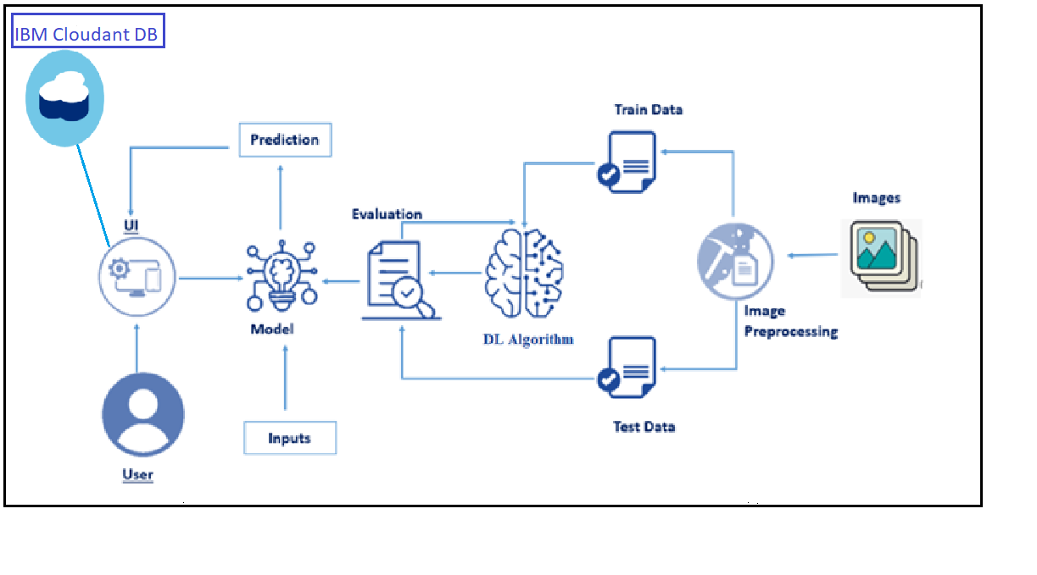
Methodology:-
To accomplish this, we have to complete all the activities and tasks listed below:
The steps to be followed to build the model are :
Data collection
Image preprocessing
Model building
Application building
Using the Flask UI to deploy the model and implementation of our application.

Slide 6
Requirements:-
Jupyter Notebook
Sypder
HTML-Hyper Text Markup Language
Flask
-Python Framework
CAR IMAGES DATA SET

Slide 7
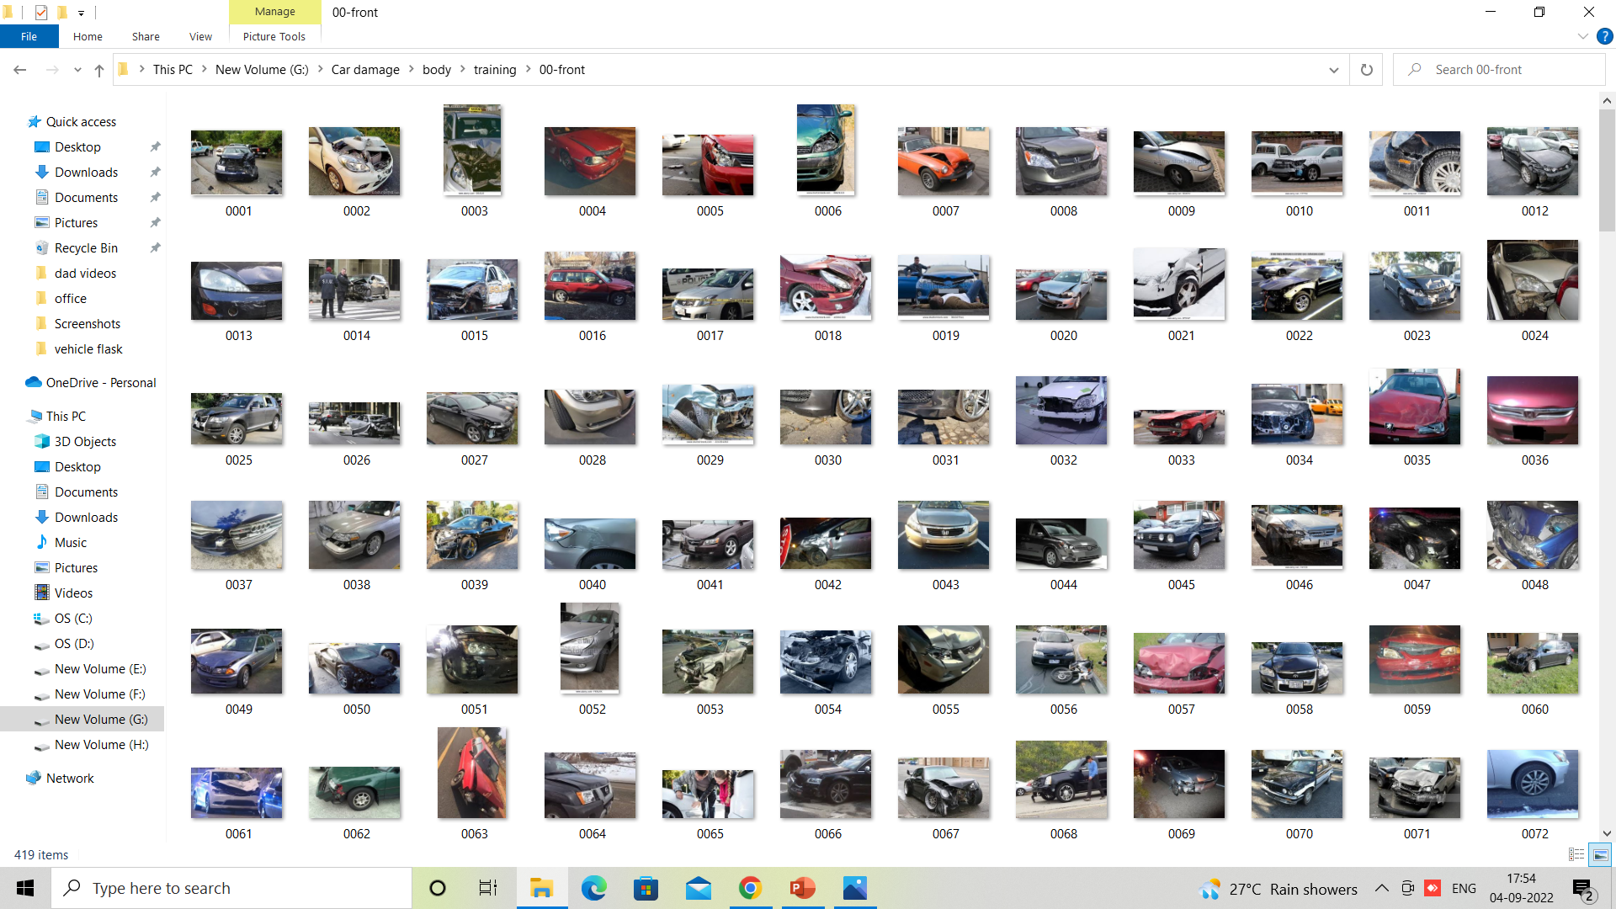
Implementation:-
The proposed system is implemented using Jupyter Notebook and Flask UI. Steps included in this implementation are Data gathering, preprocessing, model training and prediction.
Dataset collection : The dataset consists of all the car damaged pics.it consists of two colums where body (training:front,rear,side;validation:minor,major,severe)
and validation(minor,major,severe).

Slide 8
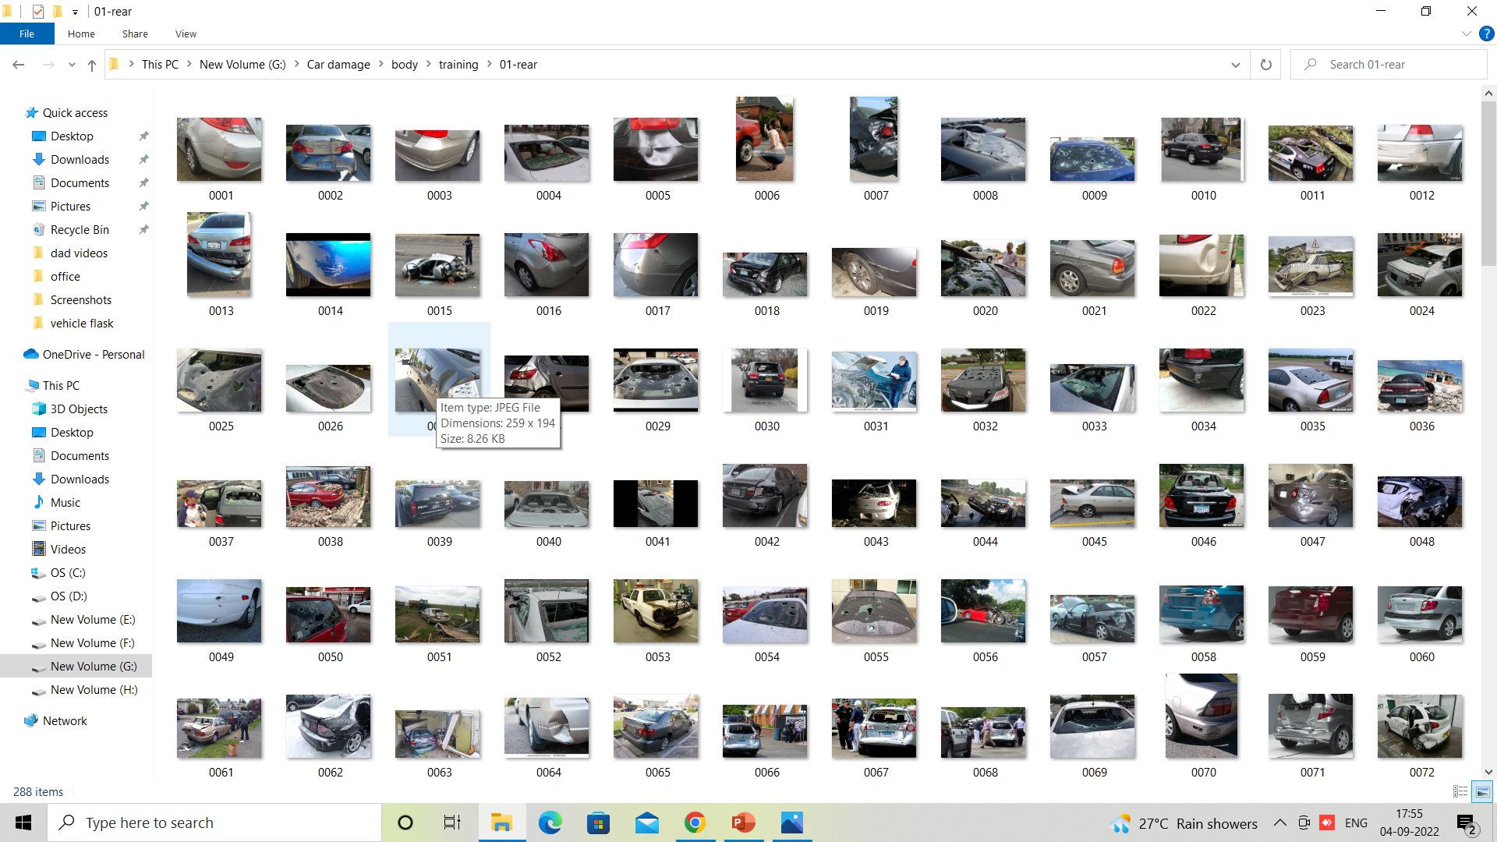
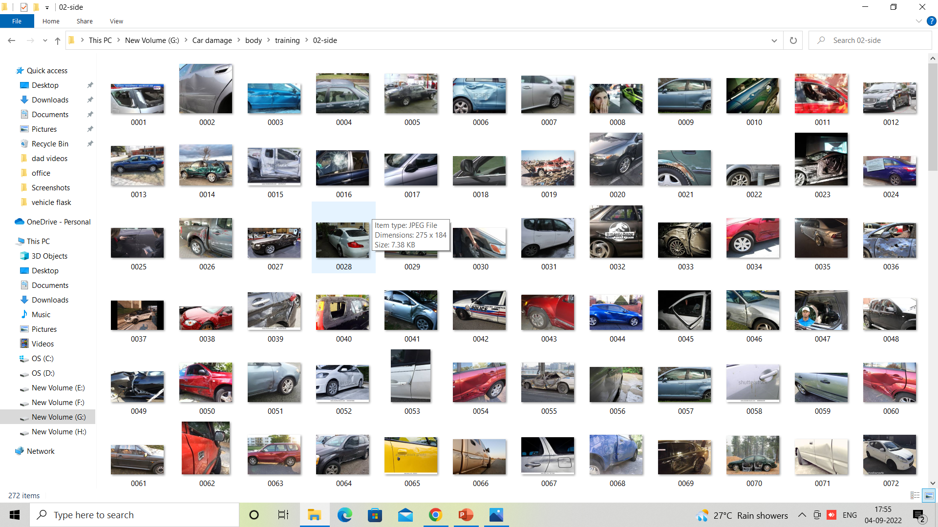
REAR AND SIDE DAMAGE PICS.

Slide 9
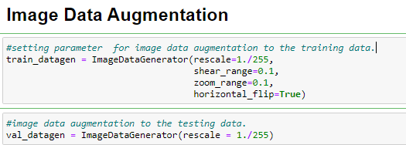
Image Preprocessing : Data preprocessing can be done in 5 steps:-
Step 1: Importing the libraries and reading the data.
Import The ImageDataGenerator Library
Configure ImageDataGenerator Class

Slide 10
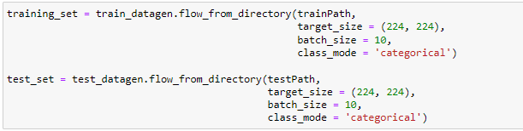
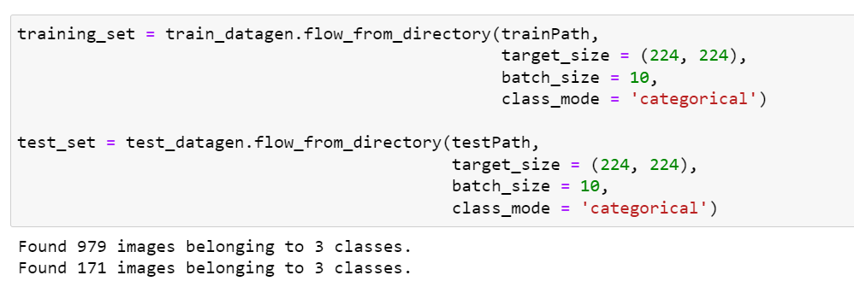
Apply ImageDataGenerator Functionality To Trainset And Testset
For Body Damage:
For level of damage:
We notice that 979 images are belonging to 3 classes for training and 171 images belong to 3 classes for testing purposes.

Slide 11
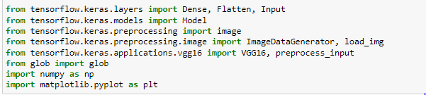
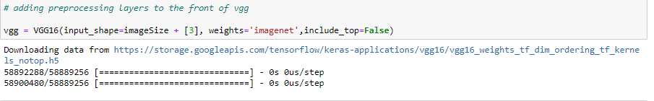
MODEL BUILDING
Importing The Model Building Libraries
Initializing The Model
The vgg16 model needs to be loaded and we are storing that into a variable called vgg.
Note: since we are training two models, so we need to initialize the two models

Slide 12
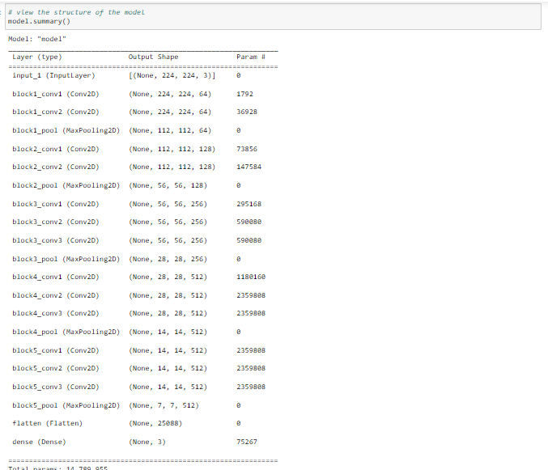
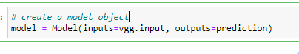
Creating A Model Object

Slide 13
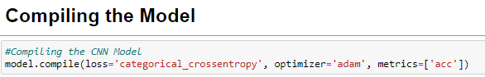
Configuring the model

Slide 14
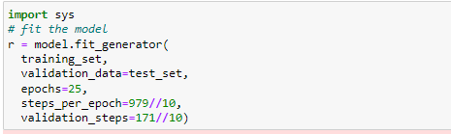
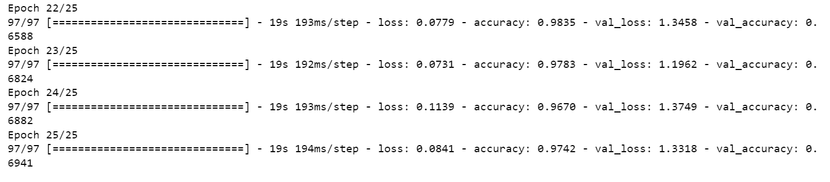
Train The Model

Slide 15
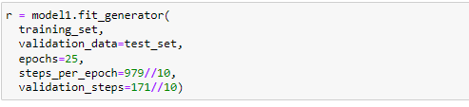
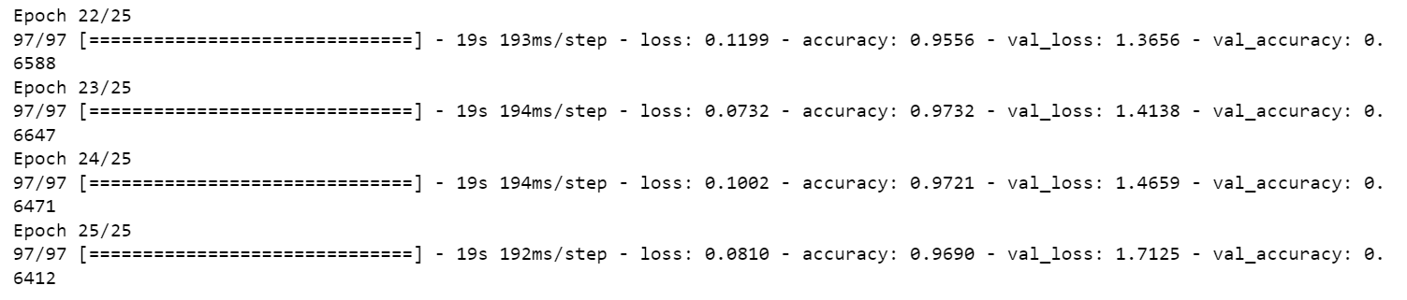

Slide 16
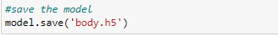
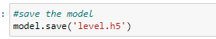
Save The Model

Slide 17
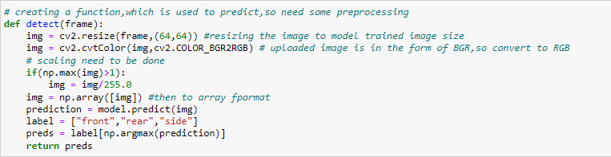
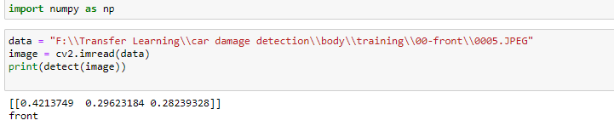
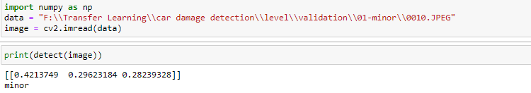
Test the model

Slide 18

Flask
Flask is a web framework
Flask provides you with tools, libraries and technologies that allow you to build a web application.
The web application can be some web pages, a blog or a commercial website

Slide 19
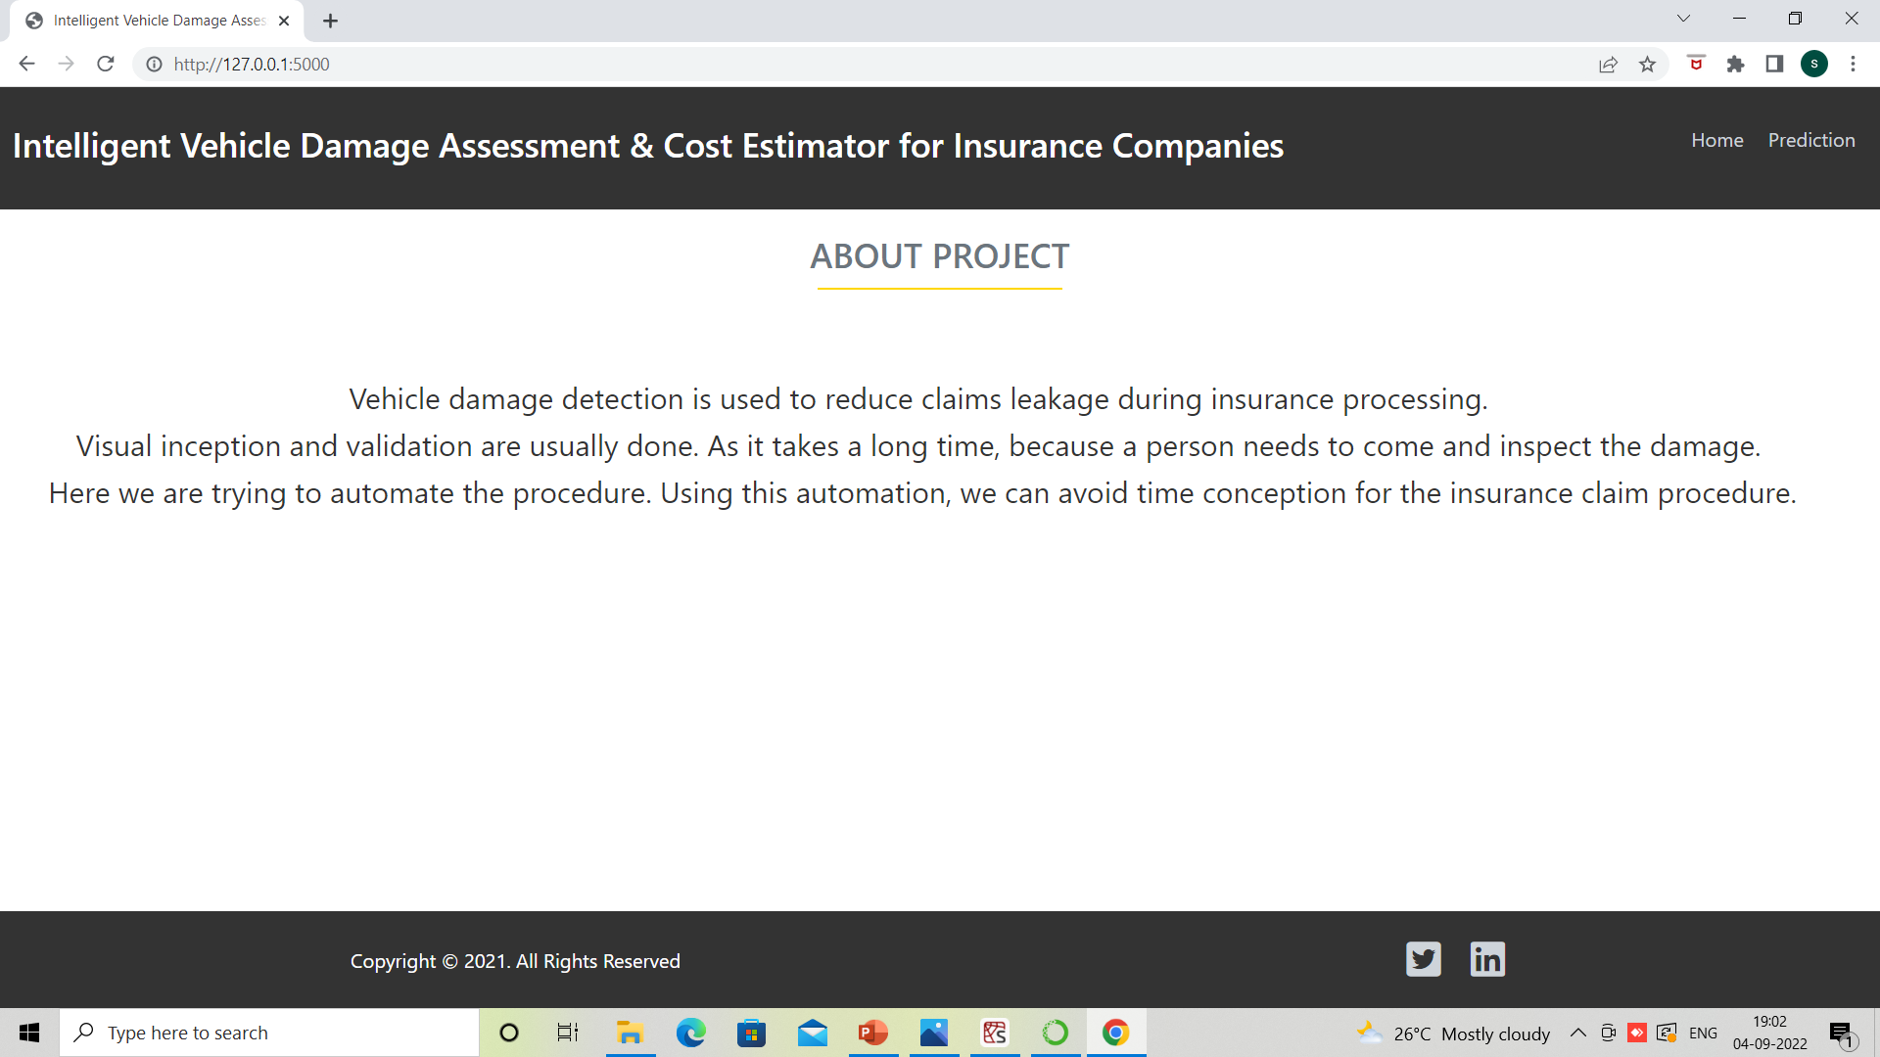
Output Screenshots

Slide 20
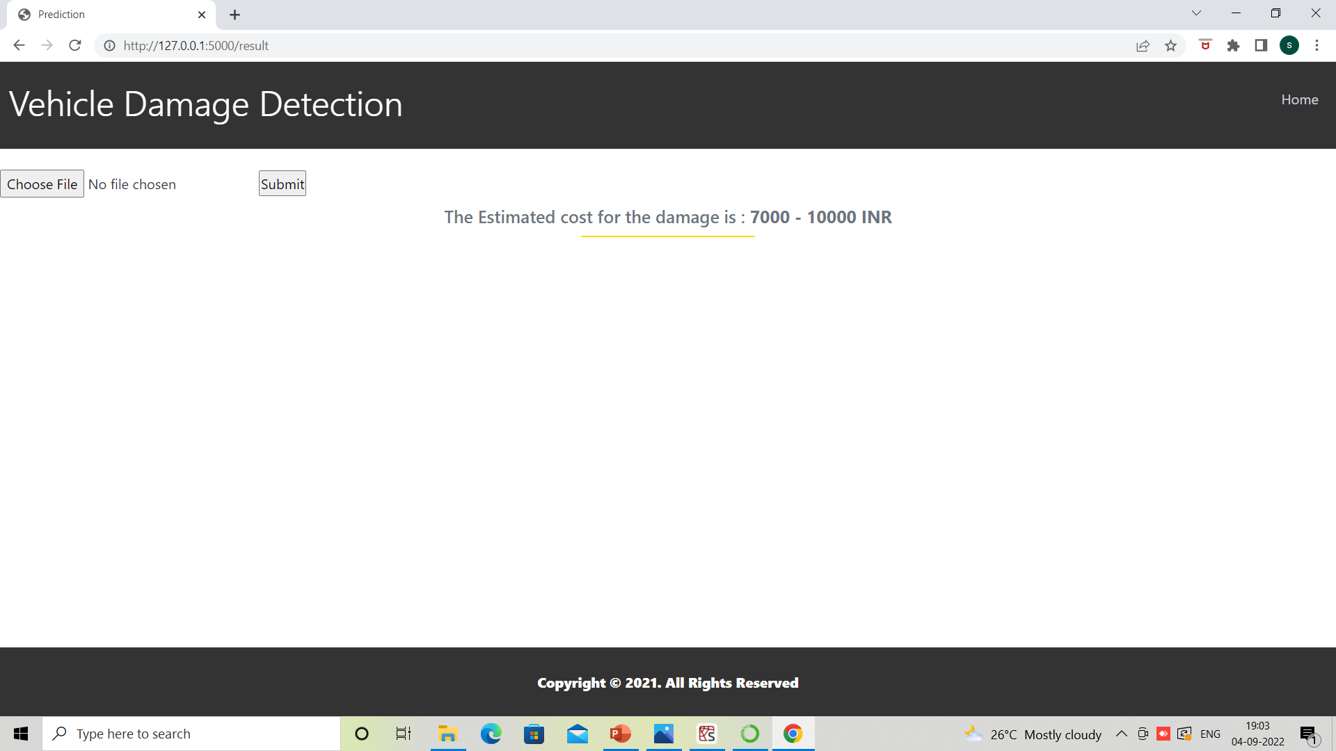
Output Screenshots

Slide 21


